Slide 1


Software Testing
Lilia Shamirian

Slide 2


Introduction
Lilia Shamirian
B.Sc(IT)
Lead QA Engineer at
7+ years experience in Test Engineering
QA Team Lead of Multi Product teams
QA Tutor at Armenian Code Academy

Slide 3


ISTQB
https://www.istqb.org/
https://glossary.istqb.org/en_US/search?term=&page=2

Slide 4
What is Testing?
What are Typical Objectives of Testing?

Slide 5
What is Testing?
Software testing is a way to assess the quality of the software and to reduce the risk of software failure in operation.
A common misperception of testing is that it only consists of running tests, i.e., executing the software and checking the results. Software testing is a process which includes many different activities; test execution (including checking of results) is only one of these activities. The test process also includes activities such as test planning, analyzing, designing, and implementing tests, reporting test progress and results and evaluating the quality of a test object.
Another common misperception of testing is that it focuses entirely on verification of requirements, user stories, or other specifications. While testing does involve checking whether the system meets specified requirements, it also involves validation, which is checking whether the system will meet user and other stakeholder needs in its operational environment(s).

Slide 6


Slide 7
Objectives of Testing
For any given project, the objectives of testing may include:
To prevent defects by evaluating work products such as requirements, user stories, design, and code
To verify whether all specified requirements have been fulfilled
To check whether the test object is complete and validate if it works as the users and other stakeholders expect
To build confidence in the level of quality of the test object
To find defects and failures thus reduce the level of risk of inadequate software quality
To provide sufficient information to stakeholders to allow them to make informed decisions, especially regarding the level of quality of the test object

Slide 8
Main Testing Types
Some testing does involve the execution of the component or system being tested; such testing is called dynamic testing. Other testing does not involve the execution of the component or system being tested; such testing is called static testing. So, testing also includes reviewing work products such as requirements, user stories, and source code.

Slide 9
Testing Principles?
Test Life Cycle and Test Activities

Slide 10
Testing Principles
1. Testing shows the presence of defects, not their absence
4. Beware of the pesticide paradox
2. Exhaustive testing is impossible
5. Testing is context dependent
3. Early testing saves time and money
6. Absence-of-errors is a fallacy
7. Defect clustering

Slide 11
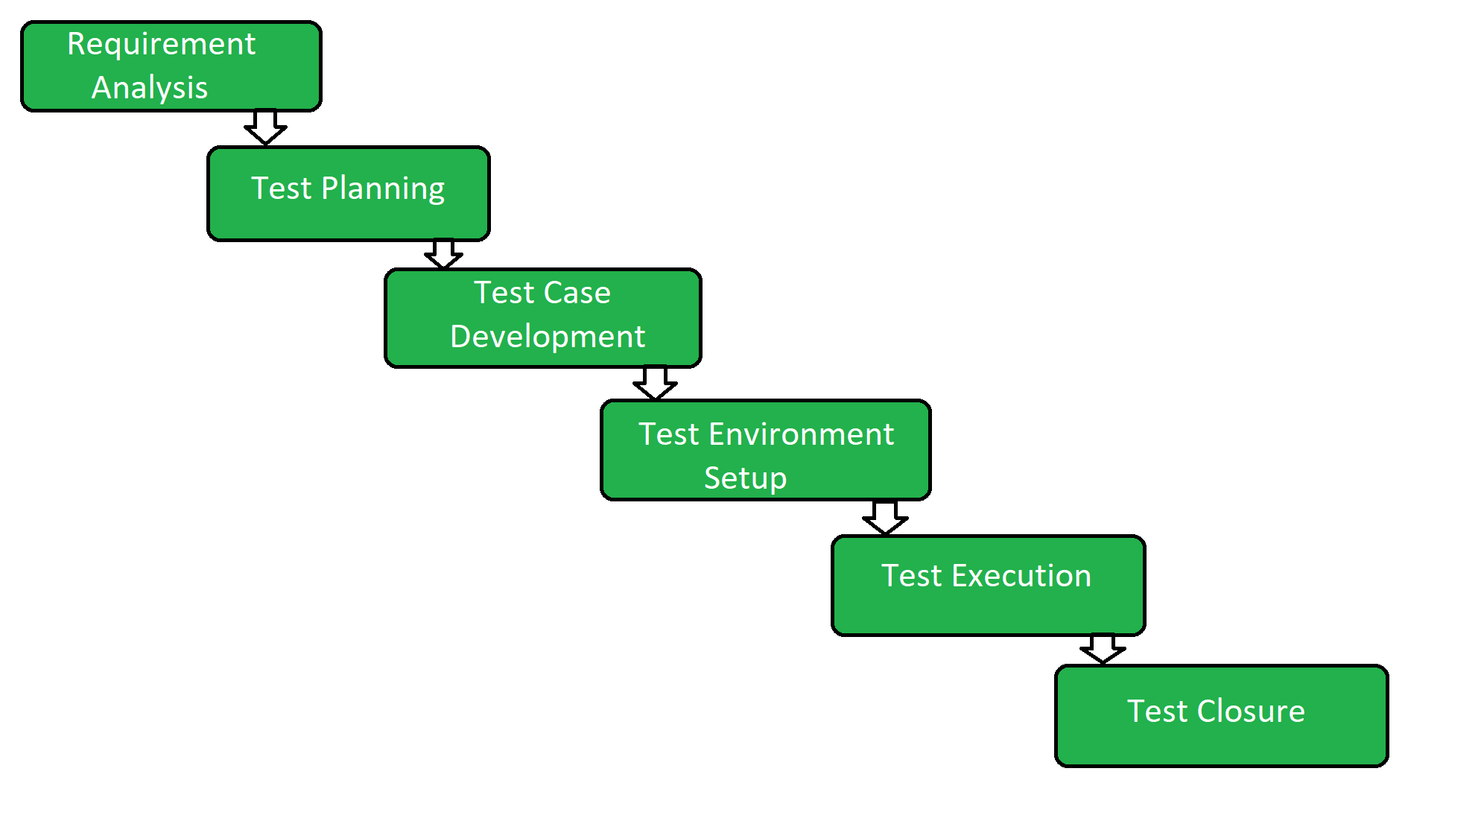
Software Testing Life Cycle (STLC)
Software Testing Life Cycle (STLC) is a sequence of different activities performed during the software testing process.
It starts as soon as requirements are defined, or software requirement document is shared by stakeholders.

Slide 12
General Order of Test Activities
Test Strategy: It outlines the overall testing approach and provides an overview of the testing types, techniques, and tools to be used for the project.
Test Approach: It provides a detailed description of the testing approach to be used, including the testing types and techniques to be employed, the scope of testing, and the timeline and resources required.
Test Plan: It provides a detailed roadmap for the testing process, including the scope, objectives, timelines, resources, and responsibilities for testing. It also includes the test scenarios and test cases that will be executed during testing.
Test Design: It involves creating a detailed test plan that outlines the test scenarios, test cases, and test data required for testing. This includes identifying the functional requirements, non-functional requirements, and acceptance criteria for the application, and developing test cases to validate these requirements.
Test Cases: It is a detailed set of steps to be executed during testing, including the expected results for each step. Test cases are derived from the test scenarios identified during the test design phase.
Test Execution: It involves the actual execution of the test cases on the application under test. Test execution is typically performed manually or using automated testing tools.
Test Report: It provides a summary of the testing process, including the results of the testing, any defects or issues found, and recommendations for further improvement. The test report is typically used to communicate the testing progress and results to stakeholders.

Slide 13
Test Documents

Slide 14
What are Test Scenarios?
A Test Scenario is defined as any functionality that can be tested. As a tester, you should put yourself in the end user’s shoes and figure out the real-world scenarios and use cases of the Application Under Test.
Why Create Test Scenarios?
Creating Test Scenarios ensures complete Test Coverage
Test Scenarios can be approved by various stakeholders like Business Analyst, Developers, Customers to ensure the Application Under Test is thoroughly tested. It ensures that the software is working for the most common use cases.
They serve as a quick tool to determine the testing work effort.
They help determine the most important end-to-end transactions or the real use of the software applications.

Slide 15
What is a Test Case?
A test case has components that describe input, action, and an expected response, in order to determine if a feature of an application works correctly.
A test case is a set of instructions on “HOW” to validate a particular test objective/target, which, when followed will tell us if the expected behavior of the system is satisfied or not.

Slide 16
Test Levels

Slide 17
Test Levels
Component(Unit) Testing
Integration Testing
Component Integration Testing
System Integration Testing
System Testing
Acceptance Testing
The purpose of Levels of testing is to make software testing systematic and easily identify all possible test cases at a particular level.

Slide 18
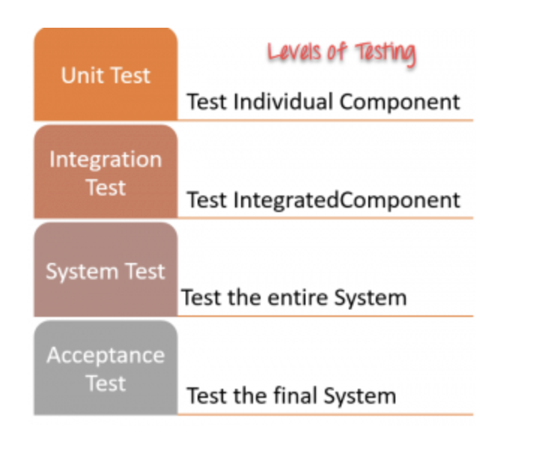
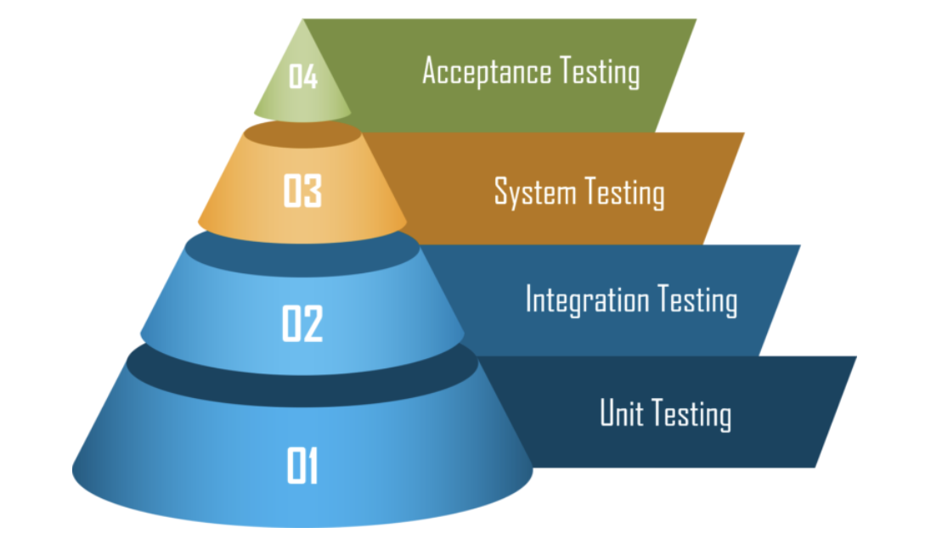

Slide 19
Test Types

Slide 20
Test Types
1.White-box testing - this testing derives tests based on the system’s internal structure or implementation. Internal structure may include code, architecture, workflows, and/or data flows within the system White-box test design and execution may involve special skills or knowledge, such as the way the code is built, how data is stored (e.g., to evaluate possible database queries), and how to use coverage tools and to correctly interpret their results.
2.Black Box Testing- This is a software testing method in which the functionalities of software applications are tested without having knowledge of internal code structure, implementation details and internal paths. Black Box Testing mainly focuses on input and output of software applications, and it is entirely based on software requirements and specifications. It is also known as Behavioral Testing.
3.Functional Testing - Functional testing of a system involves tests that evaluate functions that the system should perform. Functional requirements may be described in work products such as business requirements specifications, epics, user stories, use cases, or functional specifications, or they may be undocumented. The functions are “what” the system should do.
4. Non – Functional Testing - is defined as a type of Software testing to check non-functional aspects (performance, usability, reliability, adaptability etc.) of a software application. It is designed to test the readiness of a system as per nonfunctional parameters which are never addressed by functional testing. Non-functional testing is the testing of “how well” the system behaves. An excellent example of non-functional test would be to check how many people can simultaneously login into a software.

Slide 21
Test Types
5.Smoke testing - This is typically the first type of testing performed after a new build of the software is received from the development team. Its purpose is to quickly check if the build is stable and if the most critical functionalities are working as expected.
6.Sanity testing - This is typically performed after the smoke testing to ensure that the new changes or fixes made to the software are working as expected and have not introduced any major issues.
7.Feature testing - This is a more comprehensive testing approach that focuses on testing each feature of the software in detail to ensure that it meets the requirements and specifications. It is typically performed during the development process to identify and fix any defects before the software is released.
8.Regression testing - This is typically performed after changes have been made to the software to ensure that the existing functionalities have not been impacted and that the changes have not introduced any new defects. Regression testing can be time-consuming and resource-intensive, but it is important to ensure that the software remains reliable and of high quality, even after changes have been made to it.

Slide 22
Test Techniques

Slide 23
Popular Test Techniques
Equivalent Class Partitioning.
Boundary Value Analysis.

Slide 24
The Equivalent Class Partitioning
The equivalent class partitioning is a black box test technique that implies splitting test data into classes, where all elements are similar in some way. This technique makes sense only if the components are similar and can fit in a common group.

Slide 25

Let’s say, there is an online store that offers different shipping rates depending on a cart price. For example:
The shipping price for orders below $100 is $15.
The shipping price for orders over $100 is $5.
Free shipping on orders over $300.
We have the following price ranges to work with:
From $1 to $100.
From $100 to $300.
$300 and higher.
If you use the equivalent class partitioning technique, you get three sets of data to test:
From $1 to $100:
– valid boundary conditions: any price in the range from 1 to 99.99;
– invalid boundary conditions: any price below 1 or above 99.99;
From $100 to $300:
– valid boundary conditions: any price in the range from 100 to 299.99;
– invalid boundary conditions: any price below 100 or above 299.99;
$300 and higher:
– valid boundary conditions: any price above 299.99;
– invalid boundary conditions: any price below 300.

Slide 26
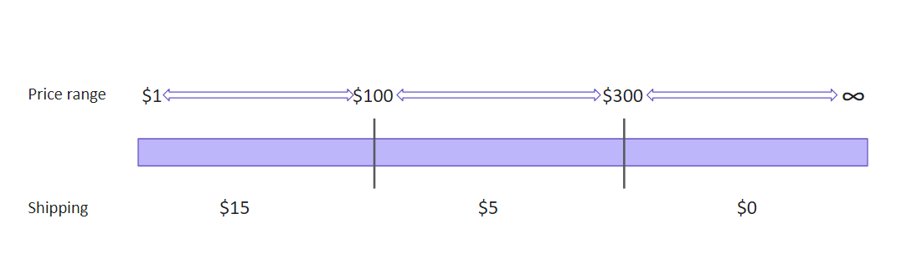
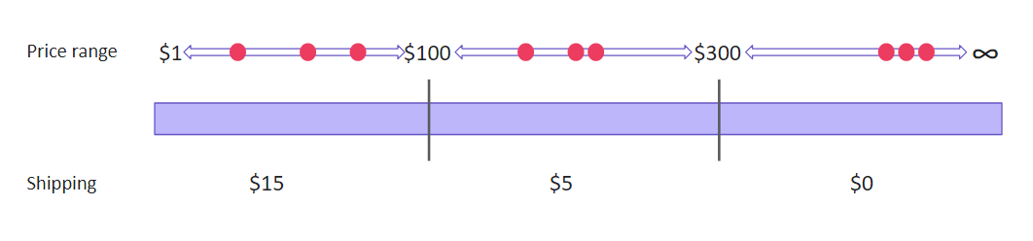

Slide 27
Boundary Value Analysis
The boundary value analysis is like the previous technique. Some may even say it is based on the equivalent class partitioning. So, what makes the boundary value analysis different? We still group data in equivalent classes but don’t test values from a particular class only. Instead, we check boundary values, those that are at the ‘borders’ of the classes.

Slide 28
Let’s take the previous scenario with varying shipping rates. We have the same data but a different approach to using it. Assuming that errors are the most likely to occur at the boundaries, we test only the ‘boundary’ numbers:
From $1 to $100:
– valid boundary conditions: 1.00, 1.01, 99.99;
– invalid boundary conditions: 0.99, 100.00, 100.01;
From $100 to $300:
– valid boundary conditions: 100.00, 100.01, 299.99;
– invalid boundary conditions: 99.99, 300.00;
$300 and higher:
– valid boundary conditions: 300.00, 300.01;
– invalid boundary conditions: 299.99.

Slide 29
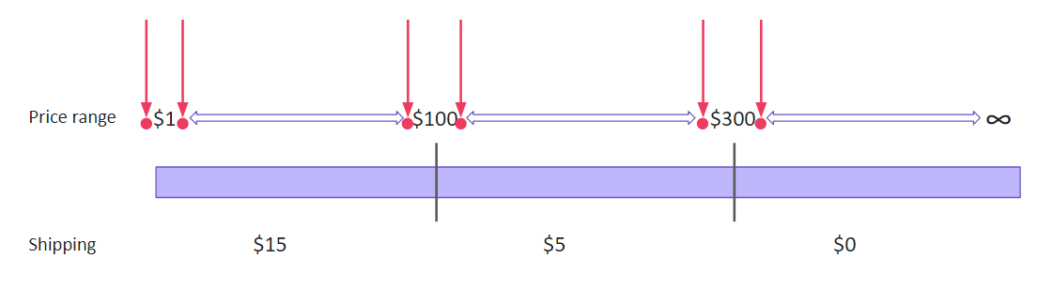

Slide 30
Q & A
Thank You
Lilia Shamirian

